Slide 1
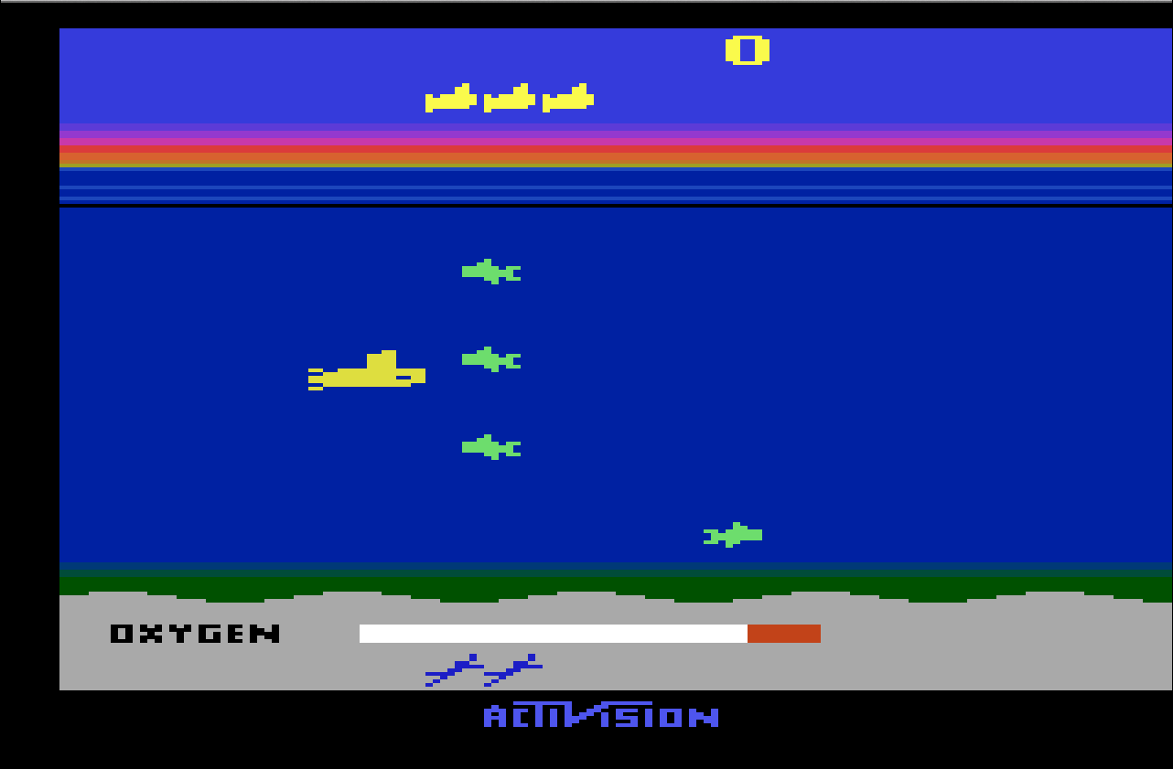
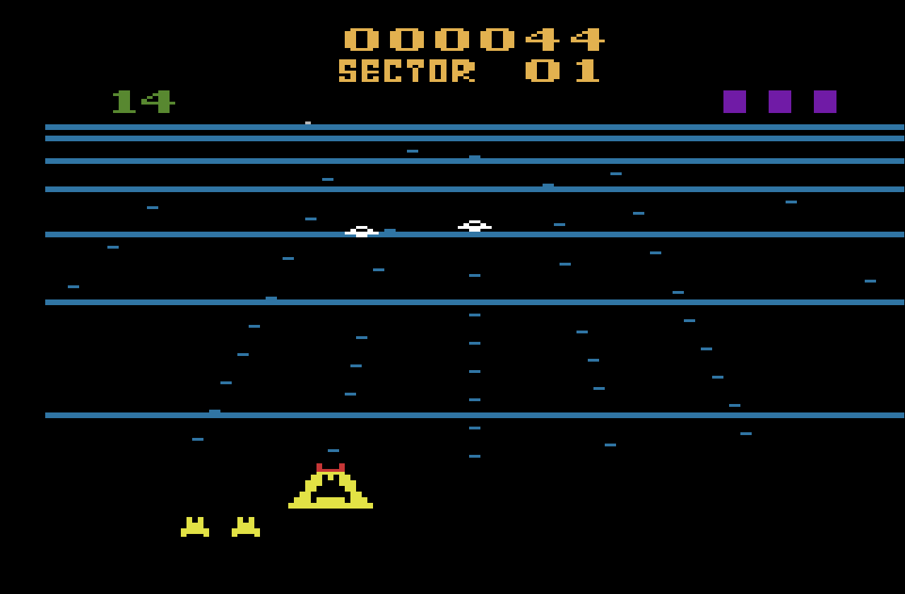
Game Playing A Reinforcement Learning Approach
By
Jainam Sheth
Abhishek Patil
Rohit Surana
<number>

Slide 2
Contents
Problem Definition
Tools Used (H/W and S/W)
Work done till date
Q-learning
Screenshots
Analysis and Design Models
Suggestions given in Sem VII exam
References
<number>

Slide 3
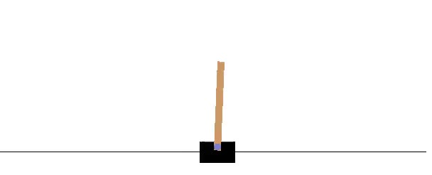
Problem Definition
To make computers play games by learning itself without being explicitly programmed.
Input will be the game environonment and reward(score).
Output will be an action which results in either a positive or negative reward.
Objective - To select an action that maximizes the score by making it play in optimized way.
<number>

Slide 4
Software Requirements
● Language – Python.
● Library and dependencies – Keras, python-pip, git.
● Editor: notepad++, text editor.
● Documentation: Microsoft word 2010.
● System Design: Draw.io.
● OS-windows 7 / Linux / Unix
<number>

Slide 5
Hardware Requirements
● Minimum 2 GB of RAM, recommended 4GB of RAM.
● Intel i3 processor,i5 or i7 recommended.
● Hard Disk - 20 GB(min)
● Speed - 1.1 GHz(min)
● Monitor - Any monitor that supports simple Atari games
<number>

Slide 6
Work Done till date
Studied Reinforcement learning from youtube lectures of David Silver.
Studied Specific topics such as implementing Artificial Neural networks using Keras library for python.
Installing OpenAi Gym.
Installing the libraries and dependencies for the project such as keras, git, python-pip.
Implementation of code for cartpole game.
Debugging and Testing the code.
Changing the hardcoded values to accepting it from the user.
<number>

Slide 7
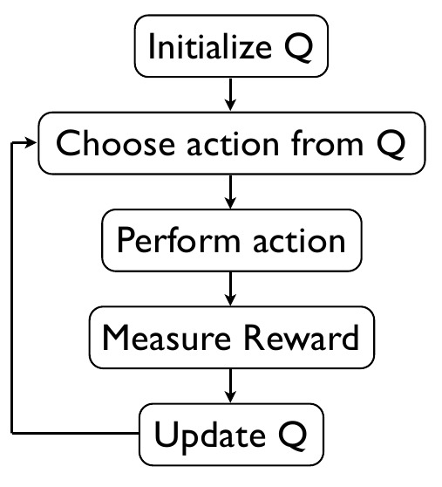
Q-learning
Q-learning is a model-free reinforcement learning technique.
Q-learning can be used to find an optimal action-selection policy for any given (finite) Markov decision process (MDP).
Q-learning is an off policy approach where it updates its Q-values using the Q-value of the next state s and the greedy action a.
Q-learning algorithm gives the optimal solution for the next action to be taken by considering the future rewards
<number>

Slide 8
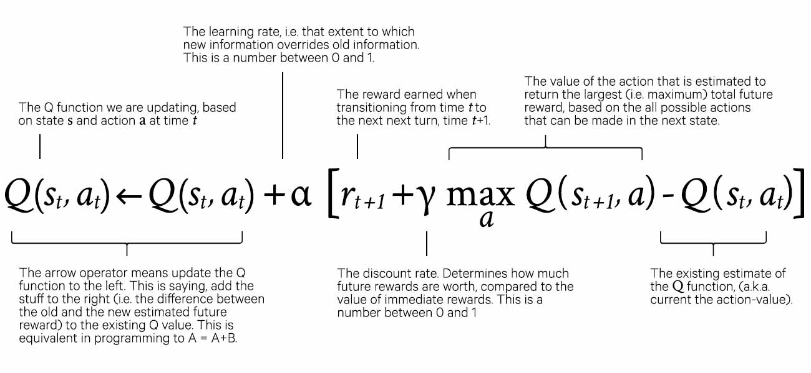
<number>

Slide 9
Experience replay
During gameplay all the experiences < s, a, r, s’ > are stored in a replay memory.
When training the network, random minibatches from the replay memory are used instead of the most recent transition.
This breaks the similarity of subsequent training samples, which otherwise might drive the network into a local minimum.
Exploration-Exploitation
A simple and effective fix for the above problem is ε-greedy exploration – with probability ε choose a random action, otherwise go with the “greedy” action with the highest Q-value.
If we pick an action with the highest Q-value, the action will be random and the agent performs crude “exploration”.
As a Q-function converges, it returns more consistent Q-values and the amount of exploration decreases.
<number>

Slide 10
Suggestions given in Sem VII exam
Reward is not always a number for example Subway Surfer. So how the agent will tackle that?
We have considered simple games like cart pole. In such games reward is a number. Complex Games like subway surfers are beyond the scope of this project.
How long will the agent play random moves and how that probability is calculated?
The agent will take moves with respect to an epsilon greedy policy. In this the agents epsilon value will be initially high and hence it will play randomly and then after every step the value of epsilon is decreased by a small amount. After the value of epsilon reaches a certain minimum value it will stop playing randomly.
Change References according to proper pattern
We have changed the references to IEEE format.
Modify the Use Case diagram
We have implemented the correct use case diagram.
<number>

Slide 11
Find how the compatibility with screen resolution is solved.
We use OpenAi Gym, all the implementation and architecture issues including compatibility are handled by it.
How are the values of gamma, epsilon decided?
The value for all the parameters are decided through trial and error. Generally the value for gamma is near to 1. While for epsilon it is near to 1 in the beginning and after that it is reduced at every step up to some minimum value.
<number>

Slide 12
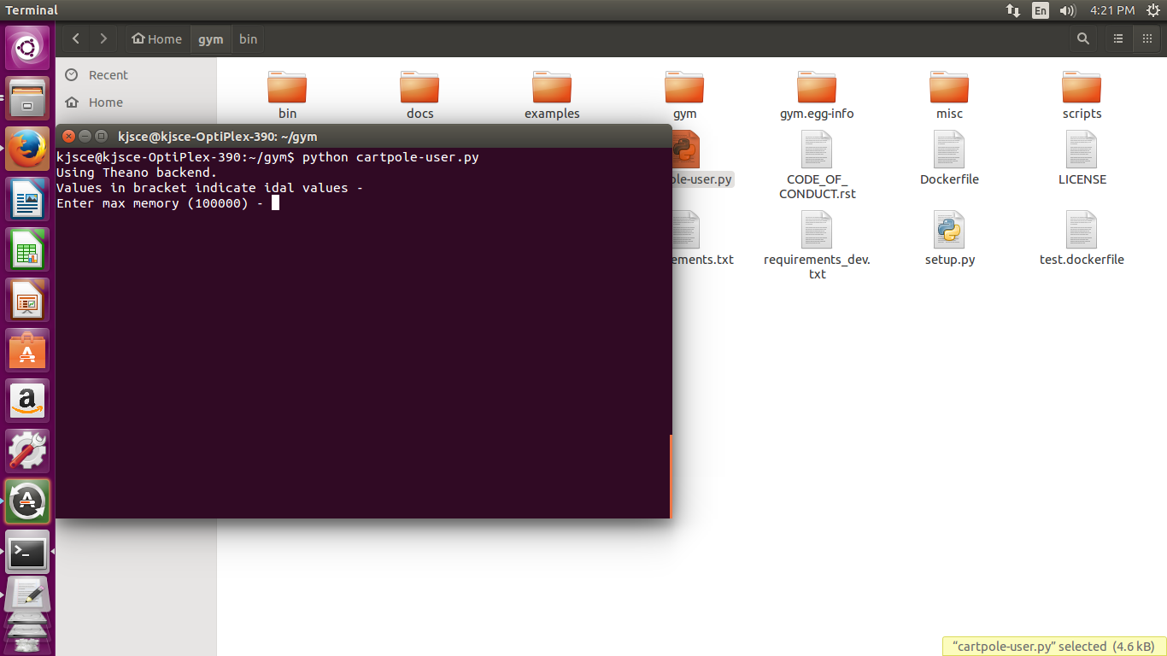
Screenshots

Slide 13
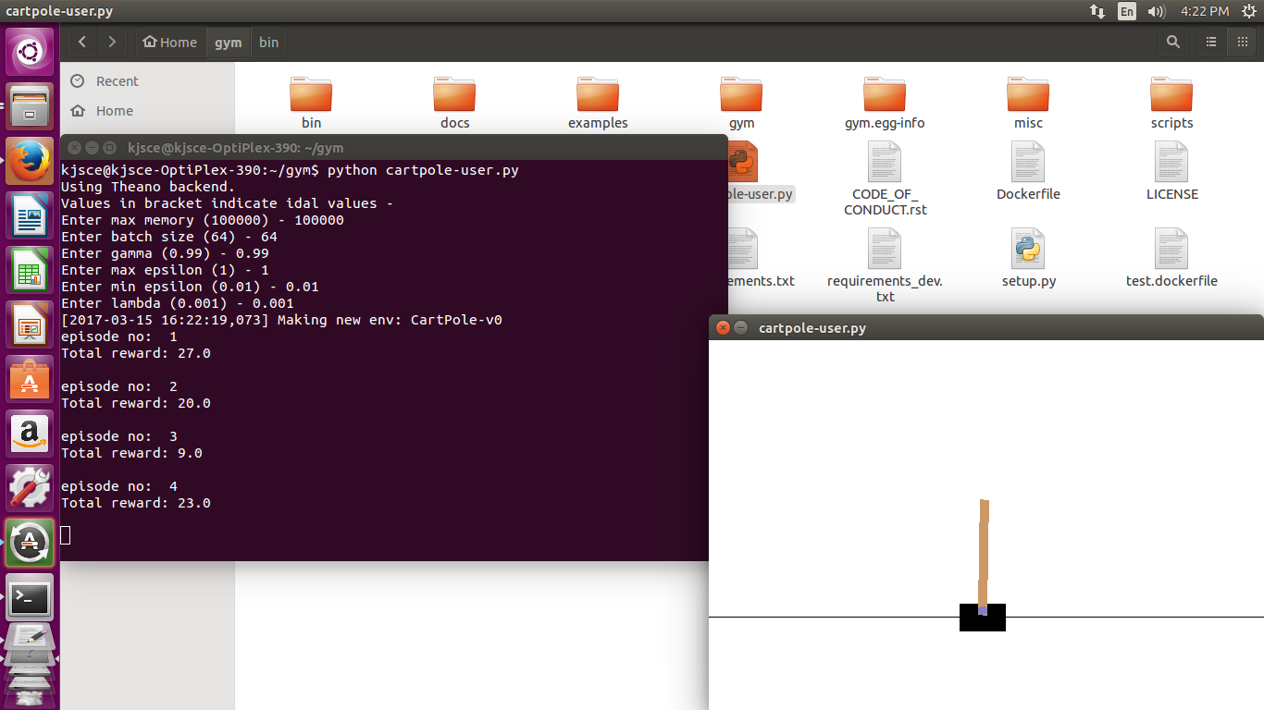

Slide 14
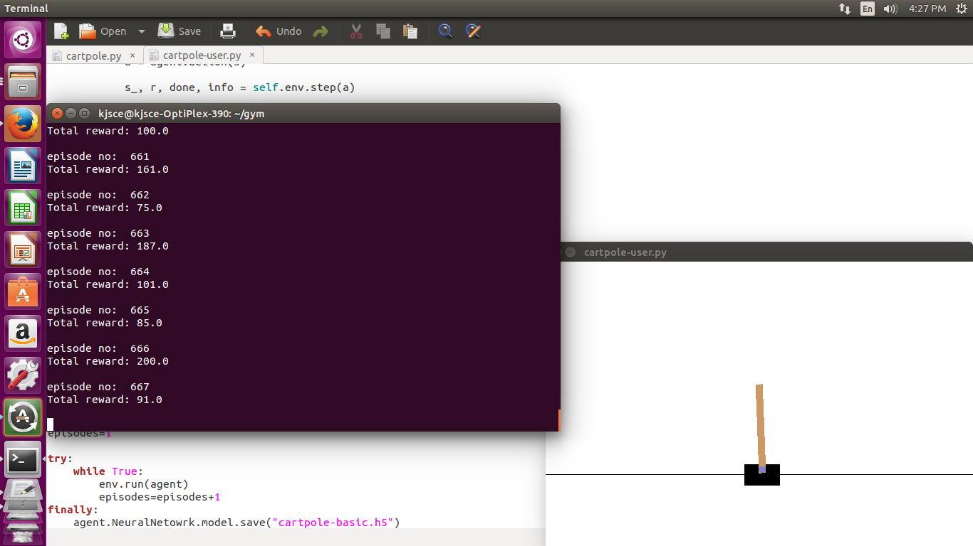

Slide 15
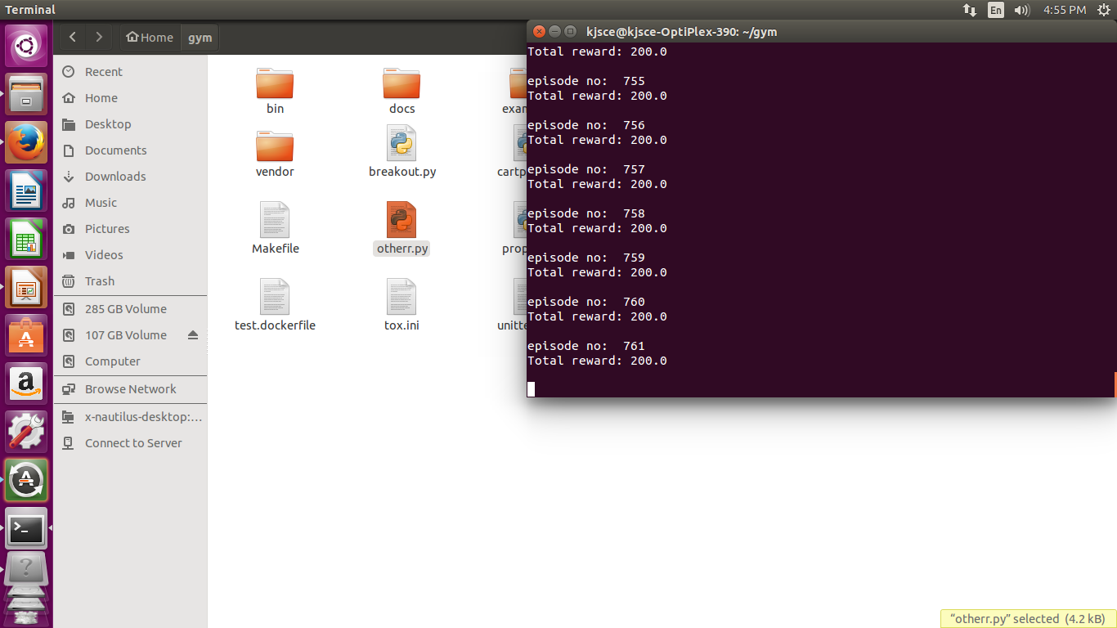

Slide 16
Design Models
<number>

Slide 17
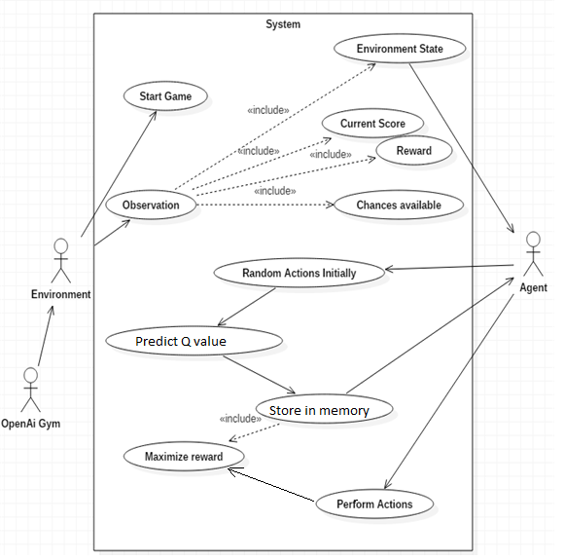
Use Case Diagram
<number>

Slide 18
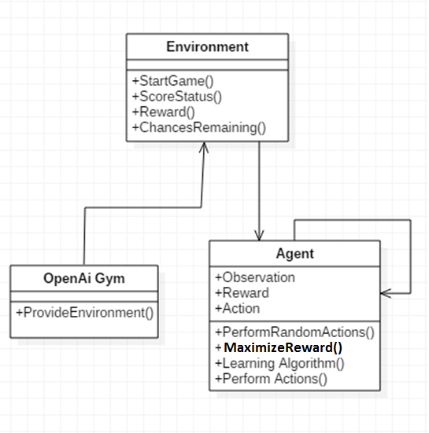
Class Diagram
<number>

Slide 19
Level 0 DFD
Level 1 DFD
<number>

Slide 20
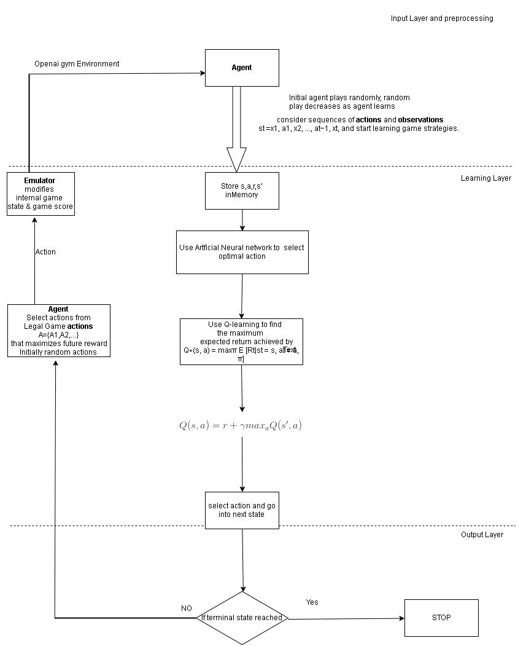
Architecture Diagram
<number>

Slide 21
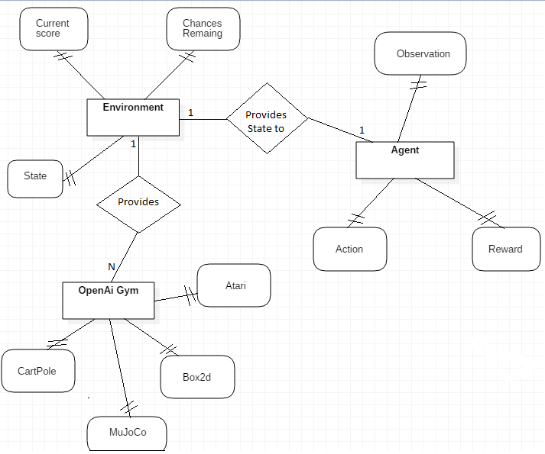
ER DIAGRAM
<number>

Slide 22
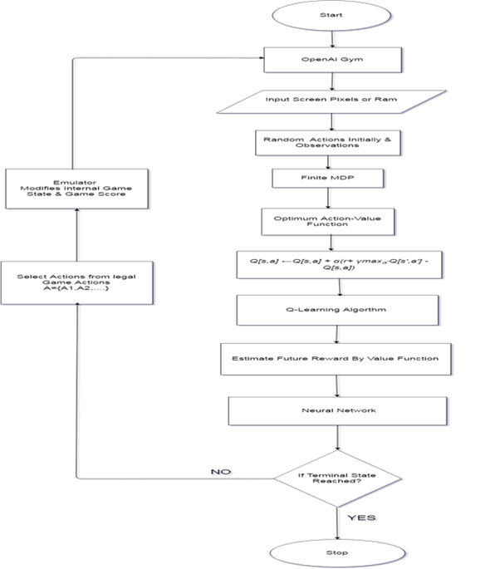
Flow Chart
<number>

Slide 23
References
[1] Mnih, V., Kavukcuoglu, K., Silver, D., Graves, A., Antonoglou, I., and Wierstra, D. (2013).Playing Atari with deep reinforcement learning. Technical report, arXiv:1312.5602.
[2] Mnih, V., Kavukcuoglu, K., Silver, D., Rusu, A. A., Veness, J., Bellemare, M. G., Graves,A., Riedmiller, M., Fidjeland, A. K., Ostrovski, G., Petersen, S., Beattie, C., Sadik, A., Antonoglou, I., King, H., Kumaran, D., Wierstra, D., Legg, S., and Hassabis, D. (2015). Human-level control through deep reinforcement learning. Nature, 518, 529–533.
[3] Hershey, David, and Blake Wulfe. "Learning to Play Atari Games.",D.(2015). Stanford Machine Learning class, 2-3
<number>

